Slide 2
(8) 超光感度のCMOS型イメージセンサーの特性
詳細は青山社出版の人工知能パートナーシステム(AIPS)を支える「デジタル回路の世界」に記載。 https://www.seizansha.co.jp/ISBN/ISBN978-4-88359-339-2.html https://www.seizansha.co.jp/

Slide 3
Recent Publications on Pinned Photodiode by Hagiwara (AIPS) +++++++++++++++++++++++++++++++++++++++++++ （１） P2019_3DIC2019_Paper_on_3D_Pinned_Photodiode_6_pages.pdf （２） P2020_EDTM2020_PaperID_3C4_by_Hagiwara_4_pages.pdf EDTM2020_Paper_on_the P+PN+P Junction Pinned Photodiode and Schottky Barrier Photodiode.html
（３） P2021_IJSSA2021_Paper_20210616_on_Electrostatic_and_Dynamic_Analysis_of_Pinned_Photodiodes.pdf P2021_IJSSA2021_Paper_20210616_on_Electrostatic_and_Dynamic_Analysis_of_Pinned_Photodiodes.html
（４） P2021_ICECET2021_Paper61.pdf
P2021_ICECET2021_Paper61_html
（５） P2021ICECET2021_Paper75.pdf
P2021_ICECET2021_Paper75_html
++++++++++++++++++++++++++++++++++++++++++++

Slide 5
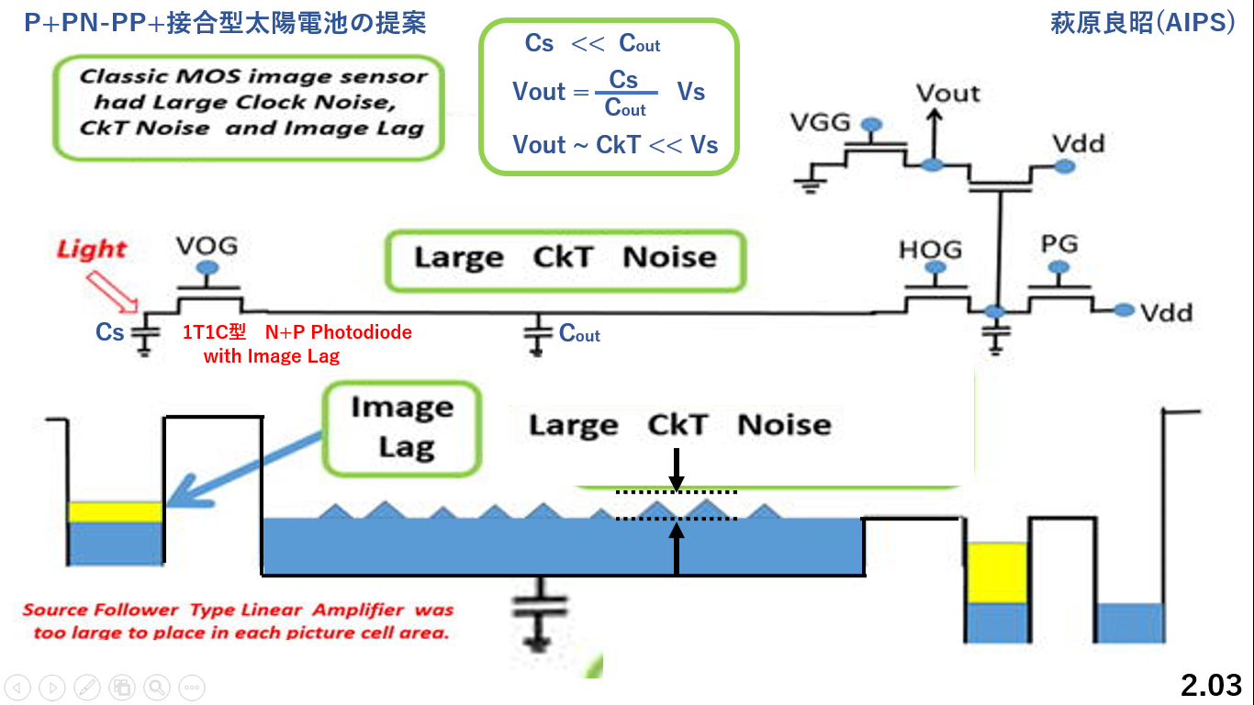

Slide 6
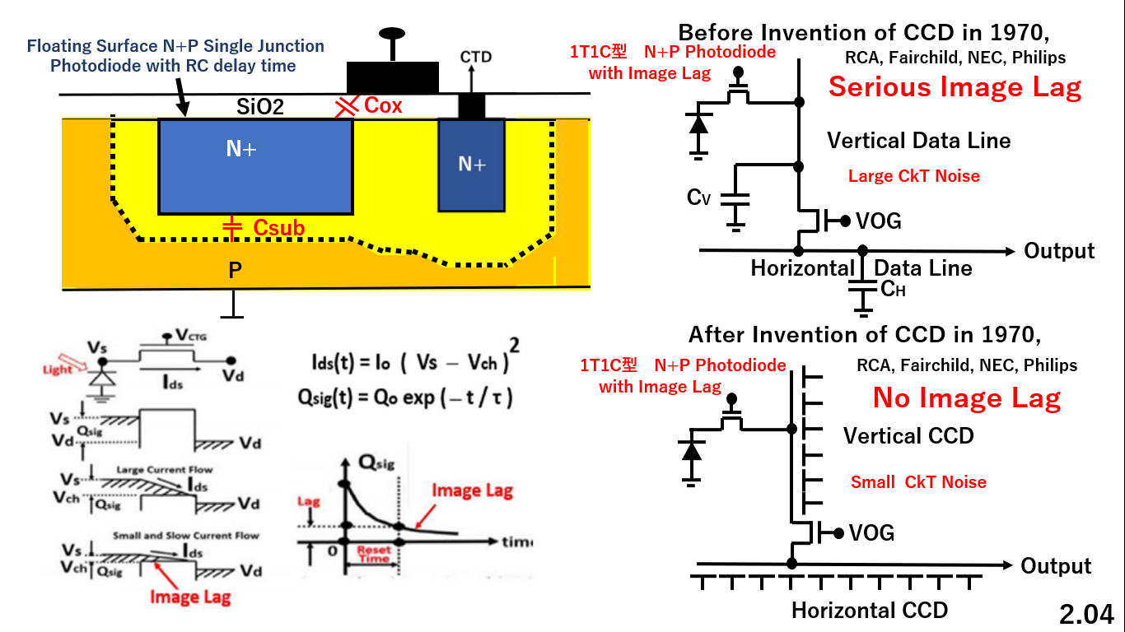

Slide 9
JPA1975_127646_裏面照射型_Global_Shutter機能つき_Pinned_Photodiode
萩原の1975年３月５日の発明が44年後の2019年3月になり実現しました。
2.07

Slide 16
半導体産業人協会日本半導体歴史館は「萩原が Pinned Photodiodeの基本提案者」と断定している。
イメージセンサ用フォトダイオードの改良（ソニー、日立、nec、東芝） (shmj.or.jp)
http://www.shmj.or.jp/museum2010/exhibi1005.html
Excellent Blue Light Sensitivity and No Image Lag
with Adjacent P+ Channel Stops
Sony SSDM1978 Paper by Hagiwara
2.14

Slide 22
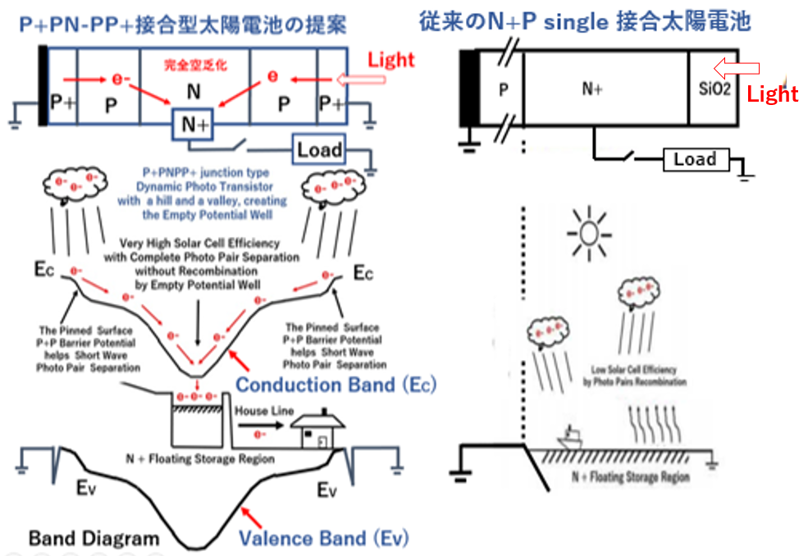
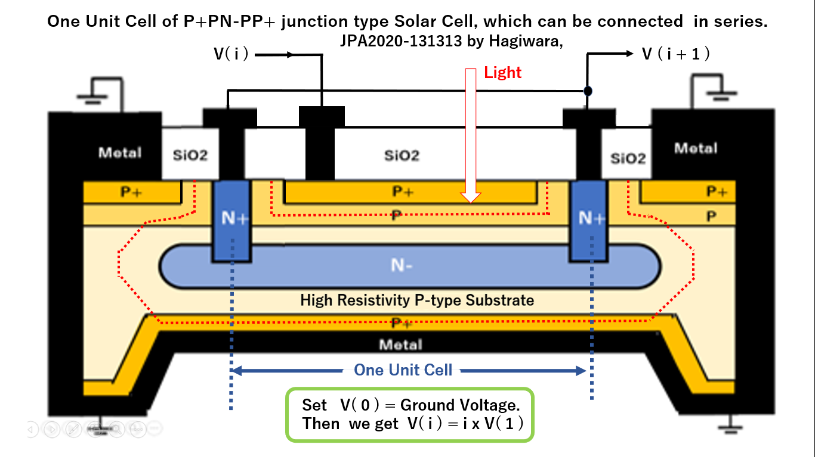
P+PN-PP+接合型太陽電池の提案 萩原良昭(AIPS)
この受光構造を超光感度の新型太陽電池として開発し将来の
日本の半導体電子デバイス産業の、「日本の産業のコメ」と
して育て、発展されて日本のエネルギ対策に貢献したいです。
（１）超短波長光感度特性を持ち
（２）Anti-blooming機能を持ち
（３）電子シャッター機能を持ち
（４）Global Shutter機能をち
（５）かつ残像のない特性をつ、
（６）受光表面がピン留めされた
Pinned Photodiodeを1975年
にもとSonyの萩原は発明した。
2.20

Slide 23
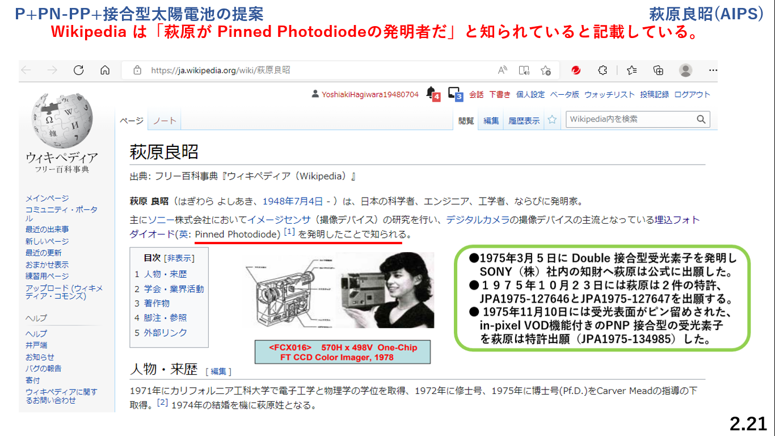

Slide 25
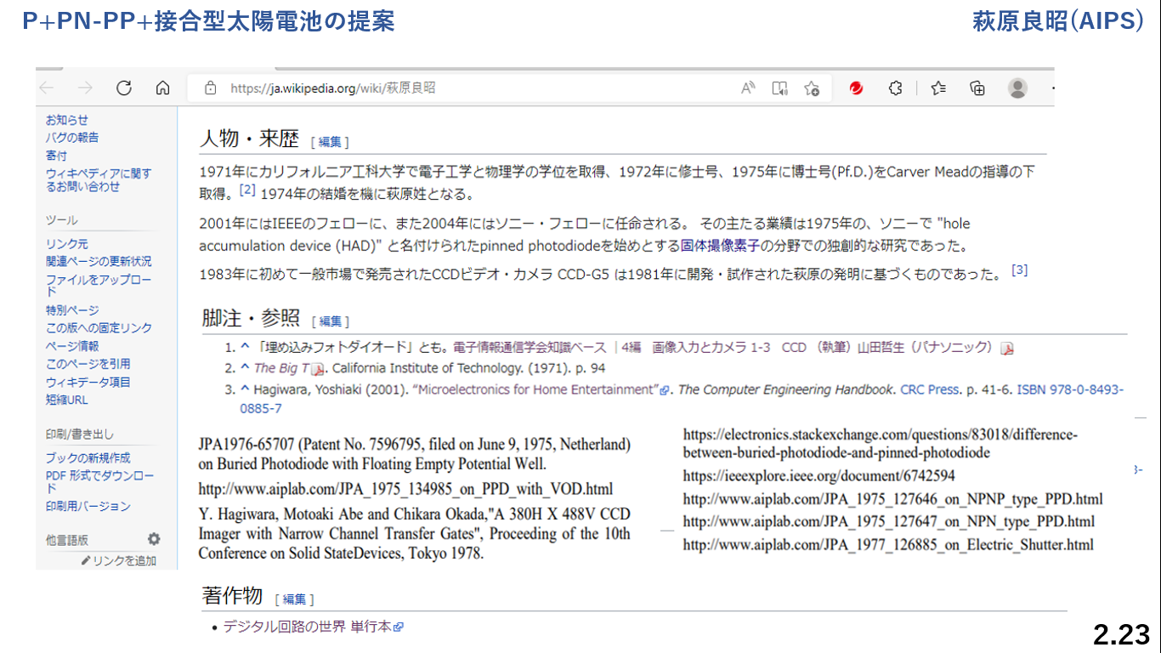

Slide 30
Recent Publications on Pinned Photodiode by Hagiwara (AIPS) +++++++++++++++++++++++++++++++++++++++++++ （１） P2019_3DIC2019_Paper_on_3D_Pinned_Photodiode_6_pages.pdf （２） P2020_EDTM2020_PaperID_3C4_by_Hagiwara_4_pages.pdf EDTM2020_Paper_on_the P+PN+P Junction Pinned Photodiode and Schottky Barrier Photodiode.html
（３） P2021_IJSSA2021_Paper_20210616_on_Electrostatic_and_Dynamic_Analysis_of_Pinned_Photodiodes.pdf P2021_IJSSA2021_Paper_20210616_on_Electrostatic_and_Dynamic_Analysis_of_Pinned_Photodiodes.html
（４） P2021_ICECET2021_Paper61.pdf
P2021_ICECET2021_Paper61_html
（５） P2021ICECET2021_Paper75.pdf
P2021_ICECET2021_Paper75_html
++++++++++++++++++++++++++++++++++++++++++++

Slide 31
（１） P2019_3DIC2019_Paper_on_3D_Pinned_Photodiode_6_pages.pdf

Slide 32
（１） P2019_3DIC2019_Paper_on_3D_Pinned_Photodiode_6_pages.pdf

Slide 33
（１） P2019_3DIC2019_Paper_on_3D_Pinned_Photodiode_6_pages.pdf

Slide 34
（１） P2019_3DIC2019_Paper_on_3D_Pinned_Photodiode_6_pages.pdf

Slide 35
（１） P2019_3DIC2019_Paper_on_3D_Pinned_Photodiode_6_pages.pdf

Slide 36
（１） P2019_3DIC2019_Paper_on_3D_Pinned_Photodiode_6_pages.pdf

Slide 37
（１） P2019_3DIC2019_Paper_on_3D_Pinned_Photodiode_6_pages.pdf

Slide 38
（１） P2019_3DIC2019_Paper_on_3D_Pinned_Photodiode_6_pages.pdf

Slide 39
（１） P2019_3DIC2019_Paper_on_3D_Pinned_Photodiode_6_pages.pdf

Slide 40
（１） P2019_3DIC2019_Paper_on_3D_Pinned_Photodiode_6_pages.pdf

Slide 41
（２） P2020_EDTM2020_PaperID_3C4_by_Hagiwara_4_pages.pdf EDTM2020_Paper_on_the P+PN+P Junction Pinned Photodiode and Schottky Barrier Photodiode.html

Slide 42
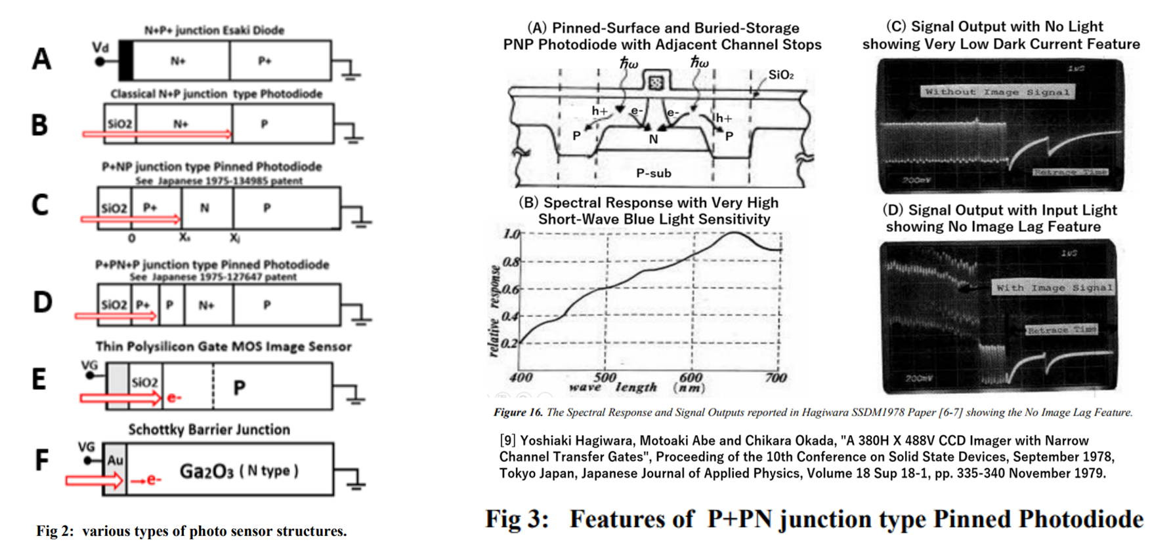
（２） P2020_EDTM2020_PaperID_3C4_by_Hagiwara_4_pages.pdf EDTM2020_Paper_on_the P+PN+P Junction Pinned Photodiode and Schottky Barrier Photodiode.html

Slide 43
（２） P2020_EDTM2020_PaperID_3C4_by_Hagiwara_4_pages.pdf EDTM2020_Paper_on_the P+PN+P Junction Pinned Photodiode and Schottky Barrier Photodiode.html

Slide 44
（２） P2020_EDTM2020_PaperID_3C4_by_Hagiwara_4_pages.pdf EDTM2020_Paper_on_the P+PN+P Junction Pinned Photodiode and Schottky Barrier Photodiode.html

Slide 45
（２） P2020_EDTM2020_PaperID_3C4_by_Hagiwara_4_pages.pdf EDTM2020_Paper_on_the P+PN+P Junction Pinned Photodiode and Schottky Barrier Photodiode.html

Slide 46
（２） P2020_EDTM2020_PaperID_3C4_by_Hagiwara_4_pages.pdf EDTM2020_Paper_on_the P+PN+P Junction Pinned Photodiode and Schottky Barrier Photodiode.html

Slide 47
（３） P2021_IJSSA2021_Paper_20210616_on_Electrostatic_and_Dynamic_Analysis_of_Pinned_Photodiodes.pdf P2021_IJSSA2021_Paper_20210616_on_Electrostatic_and_Dynamic_Analysis_of_Pinned_Photodiodes.html

Slide 48
（３） P2021_IJSSA2021_Paper_20210616_on_Electrostatic_and_Dynamic_Analysis_of_Pinned_Photodiodes.pdf P2021_IJSSA2021_Paper_20210616_on_Electrostatic_and_Dynamic_Analysis_of_Pinned_Photodiodes.html

Slide 49
（３） P2021_IJSSA2021_Paper_20210616_on_Electrostatic_and_Dynamic_Analysis_of_Pinned_Photodiodes.pdf P2021_IJSSA2021_Paper_20210616_on_Electrostatic_and_Dynamic_Analysis_of_Pinned_Photodiodes.html

Slide 50
（３） P2021_IJSSA2021_Paper_20210616_on_Electrostatic_and_Dynamic_Analysis_of_Pinned_Photodiodes.pdf P2021_IJSSA2021_Paper_20210616_on_Electrostatic_and_Dynamic_Analysis_of_Pinned_Photodiodes.html

Slide 51
（３） P2021_IJSSA2021_Paper_20210616_on_Electrostatic_and_Dynamic_Analysis_of_Pinned_Photodiodes.pdf P2021_IJSSA2021_Paper_20210616_on_Electrostatic_and_Dynamic_Analysis_of_Pinned_Photodiodes.html

Slide 52
（３） P2021_IJSSA2021_Paper_20210616_on_Electrostatic_and_Dynamic_Analysis_of_Pinned_Photodiodes.pdf P2021_IJSSA2021_Paper_20210616_on_Electrostatic_and_Dynamic_Analysis_of_Pinned_Photodiodes.html

Slide 53
（３） P2021_IJSSA2021_Paper_20210616_on_Electrostatic_and_Dynamic_Analysis_of_Pinned_Photodiodes.pdf P2021_IJSSA2021_Paper_20210616_on_Electrostatic_and_Dynamic_Analysis_of_Pinned_Photodiodes.html

Slide 54
（３） P2021_IJSSA2021_Paper_20210616_on_Electrostatic_and_Dynamic_Analysis_of_Pinned_Photodiodes.pdf P2021_IJSSA2021_Paper_20210616_on_Electrostatic_and_Dynamic_Analysis_of_Pinned_Photodiodes.html

Slide 55
（３） P2021_IJSSA2021_Paper_20210616_on_Electrostatic_and_Dynamic_Analysis_of_Pinned_Photodiodes.pdf P2021_IJSSA2021_Paper_20210616_on_Electrostatic_and_Dynamic_Analysis_of_Pinned_Photodiodes.html

Slide 56
（３） P2021_IJSSA2021_Paper_20210616_on_Electrostatic_and_Dynamic_Analysis_of_Pinned_Photodiodes.pdf P2021_IJSSA2021_Paper_20210616_on_Electrostatic_and_Dynamic_Analysis_of_Pinned_Photodiodes.html

Slide 57
（３） P2021_IJSSA2021_Paper_20210616_on_Electrostatic_and_Dynamic_Analysis_of_Pinned_Photodiodes.pdf P2021_IJSSA2021_Paper_20210616_on_Electrostatic_and_Dynamic_Analysis_of_Pinned_Photodiodes.html

Slide 58
（３） P2021_IJSSA2021_Paper_20210616_on_Electrostatic_and_Dynamic_Analysis_of_Pinned_Photodiodes.pdf P2021_IJSSA2021_Paper_20210616_on_Electrostatic_and_Dynamic_Analysis_of_Pinned_Photodiodes.html

Slide 59
（３） P2021_IJSSA2021_Paper_20210616_on_Electrostatic_and_Dynamic_Analysis_of_Pinned_Photodiodes.pdf P2021_IJSSA2021_Paper_20210616_on_Electrostatic_and_Dynamic_Analysis_of_Pinned_Photodiodes.html

Slide 60
（３） P2021_IJSSA2021_Paper_20210616_on_Electrostatic_and_Dynamic_Analysis_of_Pinned_Photodiodes.pdf P2021_IJSSA2021_Paper_20210616_on_Electrostatic_and_Dynamic_Analysis_of_Pinned_Photodiodes.html

Slide 61
（３） P2021_IJSSA2021_Paper_20210616_on_Electrostatic_and_Dynamic_Analysis_of_Pinned_Photodiodes.pdf P2021_IJSSA2021_Paper_20210616_on_Electrostatic_and_Dynamic_Analysis_of_Pinned_Photodiodes.html

Slide 62
（３） P2021_IJSSA2021_Paper_20210616_on_Electrostatic_and_Dynamic_Analysis_of_Pinned_Photodiodes.pdf P2021_IJSSA2021_Paper_20210616_on_Electrostatic_and_Dynamic_Analysis_of_Pinned_Photodiodes.html

Slide 63
（３） P2021_IJSSA2021_Paper_20210616_on_Electrostatic_and_Dynamic_Analysis_of_Pinned_Photodiodes.pdf P2021_IJSSA2021_Paper_20210616_on_Electrostatic_and_Dynamic_Analysis_of_Pinned_Photodiodes.html

Slide 64
（３） P2021_IJSSA2021_Paper_20210616_on_Electrostatic_and_Dynamic_Analysis_of_Pinned_Photodiodes.pdf P2021_IJSSA2021_Paper_20210616_on_Electrostatic_and_Dynamic_Analysis_of_Pinned_Photodiodes.html

Slide 65
（３） P2021_IJSSA2021_Paper_20210616_on_Electrostatic_and_Dynamic_Analysis_of_Pinned_Photodiodes.pdf P2021_IJSSA2021_Paper_20210616_on_Electrostatic_and_Dynamic_Analysis_of_Pinned_Photodiodes.html

Slide 66
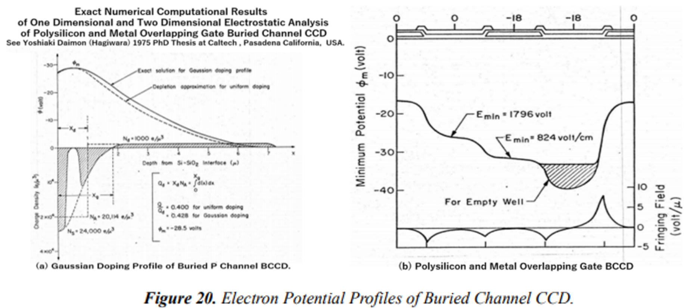
（３） P2021_IJSSA2021_Paper_20210616_on_Electrostatic_and_Dynamic_Analysis_of_Pinned_Photodiodes.pdf P2021_IJSSA2021_Paper_20210616_on_Electrostatic_and_Dynamic_Analysis_of_Pinned_Photodiodes.html

Slide 67
（３） P2021_IJSSA2021_Paper_20210616_on_Electrostatic_and_Dynamic_Analysis_of_Pinned_Photodiodes.pdf P2021_IJSSA2021_Paper_20210616_on_Electrostatic_and_Dynamic_Analysis_of_Pinned_Photodiodes.html

Slide 68
（３） P2021_IJSSA2021_Paper_20210616_on_Electrostatic_and_Dynamic_Analysis_of_Pinned_Photodiodes.pdf P2021_IJSSA2021_Paper_20210616_on_Electrostatic_and_Dynamic_Analysis_of_Pinned_Photodiodes.html

Slide 69
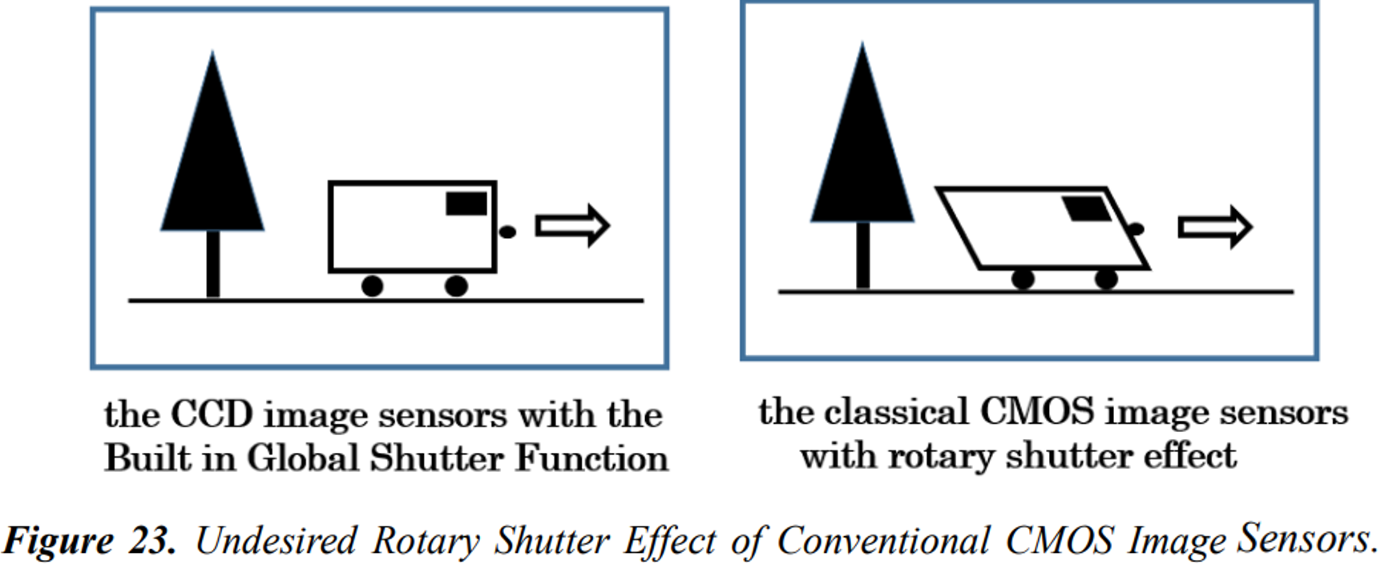
（３） P2021_IJSSA2021_Paper_20210616_on_Electrostatic_and_Dynamic_Analysis_of_Pinned_Photodiodes.pdf P2021_IJSSA2021_Paper_20210616_on_Electrostatic_and_Dynamic_Analysis_of_Pinned_Photodiodes.html

Slide 70
（３） P2021_IJSSA2021_Paper_20210616_on_Electrostatic_and_Dynamic_Analysis_of_Pinned_Photodiodes.pdf P2021_IJSSA2021_Paper_20210616_on_Electrostatic_and_Dynamic_Analysis_of_Pinned_Photodiodes.html

Slide 71
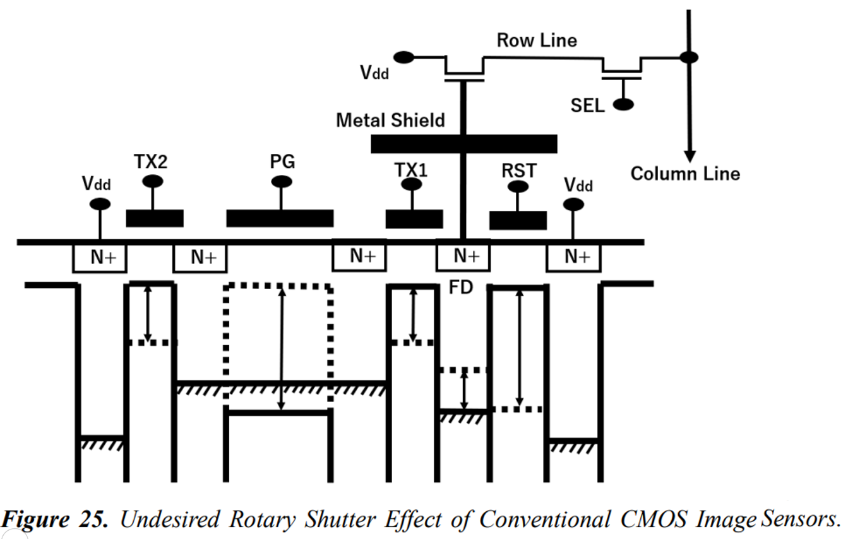
（３） P2021_IJSSA2021_Paper_20210616_on_Electrostatic_and_Dynamic_Analysis_of_Pinned_Photodiodes.pdf P2021_IJSSA2021_Paper_20210616_on_Electrostatic_and_Dynamic_Analysis_of_Pinned_Photodiodes.html

Slide 72
（３） P2021_IJSSA2021_Paper_20210616_on_Electrostatic_and_Dynamic_Analysis_of_Pinned_Photodiodes.pdf P2021_IJSSA2021_Paper_20210616_on_Electrostatic_and_Dynamic_Analysis_of_Pinned_Photodiodes.html

Slide 73
（３） P2021_IJSSA2021_Paper_20210616_on_Electrostatic_and_Dynamic_Analysis_of_Pinned_Photodiodes.pdf P2021_IJSSA2021_Paper_20210616_on_Electrostatic_and_Dynamic_Analysis_of_Pinned_Photodiodes.html

Slide 74
（３） P2021_IJSSA2021_Paper_20210616_on_Electrostatic_and_Dynamic_Analysis_of_Pinned_Photodiodes.pdf P2021_IJSSA2021_Paper_20210616_on_Electrostatic_and_Dynamic_Analysis_of_Pinned_Photodiodes.html

Slide 75
（３） P2021_IJSSA2021_Paper_20210616_on_Electrostatic_and_Dynamic_Analysis_of_Pinned_Photodiodes.pdf P2021_IJSSA2021_Paper_20210616_on_Electrostatic_and_Dynamic_Analysis_of_Pinned_Photodiodes.html

Slide 76
（３） P2021_IJSSA2021_Paper_20210616_on_Electrostatic_and_Dynamic_Analysis_of_Pinned_Photodiodes.pdf P2021_IJSSA2021_Paper_20210616_on_Electrostatic_and_Dynamic_Analysis_of_Pinned_Photodiodes.html

Slide 77
（３） P2021_IJSSA2021_Paper_20210616_on_Electrostatic_and_Dynamic_Analysis_of_Pinned_Photodiodes.pdf P2021_IJSSA2021_Paper_20210616_on_Electrostatic_and_Dynamic_Analysis_of_Pinned_Photodiodes.html

Slide 78
（３） P2021_IJSSA2021_Paper_20210616_on_Electrostatic_and_Dynamic_Analysis_of_Pinned_Photodiodes.pdf P2021_IJSSA2021_Paper_20210616_on_Electrostatic_and_Dynamic_Analysis_of_Pinned_Photodiodes.html

Slide 79
（３） P2021_IJSSA2021_Paper_20210616_on_Electrostatic_and_Dynamic_Analysis_of_Pinned_Photodiodes.pdf P2021_IJSSA2021_Paper_20210616_on_Electrostatic_and_Dynamic_Analysis_of_Pinned_Photodiodes.html

Slide 80
（３） P2021_IJSSA2021_Paper_20210616_on_Electrostatic_and_Dynamic_Analysis_of_Pinned_Photodiodes.pdf P2021_IJSSA2021_Paper_20210616_on_Electrostatic_and_Dynamic_Analysis_of_Pinned_Photodiodes.html

Slide 81
（３） P2021_IJSSA2021_Paper_20210616_on_Electrostatic_and_Dynamic_Analysis_of_Pinned_Photodiodes.pdf P2021_IJSSA2021_Paper_20210616_on_Electrostatic_and_Dynamic_Analysis_of_Pinned_Photodiodes.html

Slide 82
（３） P2021_IJSSA2021_Paper_20210616_on_Electrostatic_and_Dynamic_Analysis_of_Pinned_Photodiodes.pdf P2021_IJSSA2021_Paper_20210616_on_Electrostatic_and_Dynamic_Analysis_of_Pinned_Photodiodes.html

Slide 83
（３） P2021_IJSSA2021_Paper_20210616_on_Electrostatic_and_Dynamic_Analysis_of_Pinned_Photodiodes.pdf P2021_IJSSA2021_Paper_20210616_on_Electrostatic_and_Dynamic_Analysis_of_Pinned_Photodiodes.html
[18] Yoshiaki Hagiwara, “Home Electronics for Entertainment”, an invited talk at ESSCIEC2001, Villach, Austria, September 2001

Slide 84
（３） P2021_IJSSA2021_Paper_20210616_on_Electrostatic_and_Dynamic_Analysis_of_Pinned_Photodiodes.pdf P2021_IJSSA2021_Paper_20210616_on_Electrostatic_and_Dynamic_Analysis_of_Pinned_Photodiodes.html
[19] Yoshiaki Hagiwara, “SOI Cell Processor and Beyond ”, an invited talk at ESSCIRC2008, Edinburgh, Scotland, U.K. September 2001

Slide 85
（３） P2021_IJSSA2021_Paper_20210616_on_Electrostatic_and_Dynamic_Analysis_of_Pinned_Photodiodes.pdf P2021_IJSSA2021_Paper_20210616_on_Electrostatic_and_Dynamic_Analysis_of_Pinned_Photodiodes.html
See http://www.aiplab.com

Slide 86
（４） P2021_ICECET2021_Paper61.pdf
P2021_ICECET2021_Paper61_html

Slide 87
（４） P2021_ICECET2021_Paper61.pdf
P2021_ICECET2021_Paper61_html

Slide 88
（４） P2021_ICECET2021_Paper61.pdf
P2021_ICECET2021_Paper61_html

Slide 89
（４） P2021_ICECET2021_Paper61.pdf
P2021_ICECET2021_Paper61_html

Slide 90
（４） P2021_ICECET2021_Paper61.pdf
P2021_ICECET2021_Paper61_html

Slide 91
（４） P2021_ICECET2021_Paper61.pdf
P2021_ICECET2021_Paper61_html

Slide 92
（４） P2021_ICECET2021_Paper61.pdf
P2021_ICECET2021_Paper61_html

Slide 93
（４） P2021_ICECET2021_Paper61.pdf
P2021_ICECET2021_Paper61_html

Slide 94
（４） P2021_ICECET2021_Paper61.pdf
P2021_ICECET2021_Paper61_html

Slide 95
（４） P2021_ICECET2021_Paper61.pdf
P2021_ICECET2021_Paper61_html

Slide 96
（４） P2021_ICECET2021_Paper61.pdf
P2021_ICECET2021_Paper61_html
REFERENCES
[1] https://mainichi.jp/english/articles/20181026/p2a/00m/0na/036000c
[2] http://www.aiplab.com/JPA_2020_131313_on_PPD_Solar_Cell.html
[3] http://www.aiplab.com/JPA_1975_134985_on_PPD_with_VOD.html
[4] http://www.aiplab.com/JPA_1977_126885_on_Electric_Shutter.html
[5] http://www.aiplab.com/JPA_1975_127646_on_NPNP_type_PPD.html
[6] http://www.aiplab.com/JPA_1975_127647_on_NPN_type_PPD.html
[7] https://en.wikipedia.org/wiki/Herbert_Kroemer

Slide 97
（５） P2021ICECET2021_Paper75.pdf
P2021_ICECET2021_Paper75_html

Slide 98
（５） P2021ICECET2021_Paper75.pdf
P2021_ICECET2021_Paper75_html

Slide 99
（５） P2021ICECET2021_Paper75.pdf
P2021_ICECET2021_Paper75_html

Slide 100
（５） P2021ICECET2021_Paper75.pdf
P2021_ICECET2021_Paper75_html

Slide 101
（５） P2021ICECET2021_Paper75.pdf
P2021_ICECET2021_Paper75_html

Slide 102
（５） P2021ICECET2021_Paper75.pdf
P2021_ICECET2021_Paper75_html

Slide 103
（５） P2021ICECET2021_Paper75.pdf
P2021_ICECET2021_Paper75_html

Slide 107
Who invented Pinned Photodiode ?
Hagiwara at Sony invented Pinned Photodiode in 1975. The evidence is give by the three Japanese patent applications, JPA1975-127646, JPA1975-127647 and JPA1975-134985. The first Pinned Photodiode was defined in October 23, 1975 as the N+NPNP triple junction( in Fig. 7 of JAP1975-127646) type and the N+NPN double junction type ( in Fig. 7 of JAP1975-127647) type photodiodes with the N+ type pinned surface and the P type buried photo charge storage region with the complete charge transfer capability and the no-image-lag feature. The photo charge is transferred and drained to the CCD/MOS type charge storage buffer memory quicky by the strong punch-thru action. The second Pinned Photodiode was defined in November 10, 1975 as the PNP double junction ( in Fig. 6 of JAP1975-134985) type photodiode with the vertical overflow drain action also with the complete charge transfer capability and the no-image-lag feature as evidence the empty potential well of the buried photo charge storage, completely depleted of the charge.
JPA1975-127646 Fig. 7
JPA1975-127647 Fig. 7
JPA1975-134985 Fig. 6

Slide 108
Who invented Electric Shutter ?
Hagiwara at Sony invented Electric Shutter in October 23, 1975. The evidence is give and explained in Fig. 7 of the Japanese patent application, JPA1975-127646, in which the first Electric Shutter function was defined. The photo charge is transferred and drained to the in-pixel buried channel type vertical overflow drain (VOD) region, which is defined as the buried channel region of the buried channel type CCD/MOS buffer memory capacitor. The three-voltage-level clocking scheme (Clock C and D) of the first Electric Shutter Function mode was defined in Fig. 7 of JPA1975-127646, using the strong punch-thru action mode between the buried P type photo charge storage region
and the P-type in-pixel vertical overflow drain (VOD) region. The strong draining gate clock D voltage as shown by creates the very deep potential well in the in-pixel P-type buried vertical overflow drain (VOD) region in case of
Fig. 7 of JPA1975-127646 while the strong draining gate clock C voltage creates the very deep potential well in the
in-pixel surface N-type inverted region in case of Fig. 7 of JPA1975-127647.
Hagiwara at Sony invented in 1975
the first Electric Shutter Function.
To achieve the complete Electric
Shutter function, the surface of
the photodiode must be pinned
and fixed by the external constant
voltage with the zero resistance.
The first Pinned Photodiode was
invented by Hagiwara in 1975 to
achieve the electric shutter function.
JPA1975-127646 Fig. 7
JPA1975-127647 Fig. 7

Slide 109
First Pinned Photodiode was invented by Hagiwara in 1975 in order to realize Electric Shutter.

Slide 110
First Pinned Photodiode was invented by Hagiwara in 1975 in order to realize Electric Shutter.

Slide 111
First Pinned Photodiode was invented by Hagiwara in 1975 in order to realize Electric Shutter.

Slide 112
First Pinned Photodiode was invented by Hagiwara in 1975 in order to realize Electric Shutter.
Sony never used LOCOS isolation in image sensors. Instead, Sony used the high energy ion implantation since 1978
to form the adjacent heavily doped P+ channel stops with Lamp Anneal Method invented by Nishiyama at Sony.
(1)
Philips JPA1976-65705
(2)
Hitachi JPA1977-837
(3)
Sony SSDM1978 paper
(4)
SSIS Japan Semiconductor
History Museum
RC delay between the surface
and the grounded substrate
Floating Surface
with Image Lag
Pinned Surface with No Image Lag
Pinned Surface with No Image Lag
LOCOS
Priority June 9, 1975
Type (3) and (4) have the adjacent P+ channel stops.
Type (1) and (5) do not have
the completely pinned surface
and both suffer RC time delay.
Type (2) ,(6) and (7) use LOCOS Isolation which has the high-resistivity side walls.
(5) Pinned Photodiode reported
by Teranishi in 2014
(4) Pinned Photodiode reported
at IEDM1984 by KODAK
(7)
(6)
(5)
Buried Photodiode reported
at IEDM1982 by NEC
LOCOS
LOCOS
No Channel Stops

Slide 113
First Pinned Photodiode was invented by Hagiwara in 1975 in order to realize Electric Shutter.
Using the thin Poly Si gate CCD/MOS capacitor type Photo Senor, Sony’s Interline Transfer CCD Image Sensors
in 1980 had no-image-lag. And using the Overflow Drain (OFD) of the in-pixel anti-blooming feature, the Punch-thru Clocking Scheme to realize the Electric Shutter function was invented by Hagiwara in 1977. See JP1977-126885.

Slide 114
First Pinned Photodiode was invented by Hagiwara in 1975 in order to realize Electric Shutter.
Using the thin Poly Si gate CCD/MOS capacitor type Photo Senor, Sony’s Interline Transfer CCD Image Sensors
in 1980 had no-image-lag. And using the Overflow Drain (OFD) of the in-pixel anti-blooming feature, the Punch-thru Clocking Scheme to realize the Electric Shutter function was invented by Hagiwara in 1977. See JP1977-126885.
(1) Integration Time
(2) Reset Time
with no Image lag
(3) Anti-blooming
and Gamma Mode
(4) Electric Shutter
Punch-thru Mode
OFD
OFD
OFD
OFD

Slide 115
First Pinned Photodiode was invented by Hagiwara in 1975 in order to realize Electric Shutter.

Slide 116
First Pinned Photodiode was invented by Hagiwara in 1975 in order to realize Electric Shutter.

Slide 117
(8) 超光感度のCMOS型イメージセンサーの特性
詳細は青山社出版の人工知能パートナーシステム(AIPS)を支える「デジタル回路の世界」に記載。 https://www.seizansha.co.jp/ISBN/ISBN978-4-88359-339-2.html https://www.seizansha.co.jp/
Thank You !

